Slide 1
Movie Recommendation Engine and Feedback Analysis
Alexander Karl, Ankit Kumar, Edwin Amponsah,
Ross Brancati and Sathvik Thogaru
Stat 535 Final Project
November 30, 2021

Slide 2
Lab 4: Movie Recommendation
Lab Goal
Use past movie ratings to predict how users will rate unwatched movies and generate recommendations for these users
Recommendation Systems
Movie recommendation systems feeds new user ratings into an engine to generate future recommendations, so recommendations are constantly updated
Our Extension
Check if the initial preferences of the group of users change as more movies are seen
Check if group is recommended with a varying set of movies over time
Check is recommendations will converge to highly rated genre as more movies are seen

Slide 3
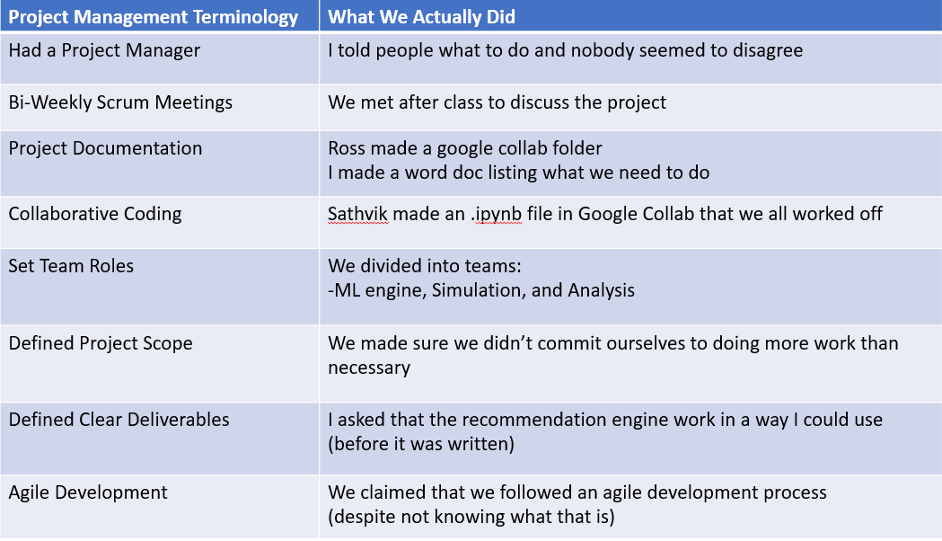
Step 0: Project Management A necessary evil

Slide 4
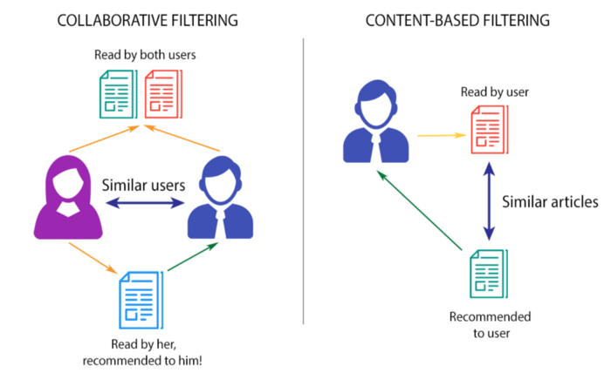
Recommendation System Approaches
Collaborative Filtering uses a user’s past behavior as well as similar decisions made by other users.
Can be user-based or item-based
Content-based filtering uses characteristics of an item and recommends items with similar characteristics
Notes:
User based models, as the name suggests, are based on user attributes and are often more challenging to implement due to the dynamic nature of users (they are often changing their ratings and what they are interested in)
Item based approaches are preferable because items do not really change much. For example, their genre and year does not change
Collaborative filtering suffers from the cold start problem (if an item is not seen during training, the system cannot generally create an embedding for it and hence cannot query the model with this item) - https://analyticsindiamag.com/collaborative-filtering-vs-content-based-filtering-for-recommender-systems/
Content-based filtering uses the characteristics of an item, in our case a movie, to recommend similar movies
Given that user’s often change over time, this method does not do a good job of handling the dynamic nature of users
Given that collaborative filtering is used in movie recommendation systems such as Netflix
Photos: https://towardsdatascience.com/prototyping-a-recommender-system-step-by-step-part-1-knn-item-based-collaborative-filtering-637969614ea

Slide 5
Methods: Overview
Part 1: Recommendation Engine Development
Collaborative filtering techniques
Algorithms:
K-Nearest Neighbors using cosine similarity
Matrix Factorization
Part 2: Simulation
Simulate users rating movies to check:
If recommendations change over time
How they may change
If global recommendations converge to one or more popular movies

Slide 6
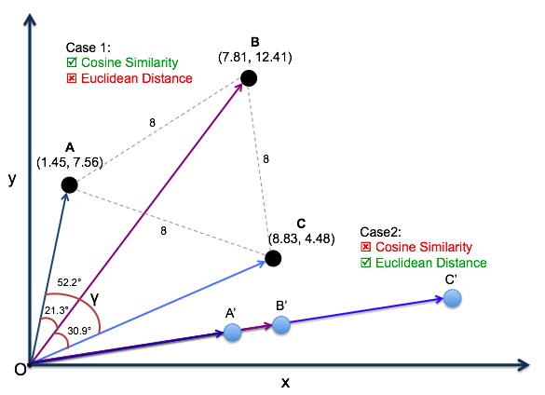
Methods: Recommendation Engine Development
KNN suffers from curse of dimensionality if it uses euclidean distance, so we took the approach of using cosine similarity instead. The euclidean distance will result in almost all vectors being equidistant to the target features
KNN has drawbacks as well including popularity bias, the cold-start problem, and scalability issues
Instead, we used a matrix factorization machine learning technique
Notes:
Photo credit: https://medium.com/@sasi24/cosine-similarity-vs-euclidean-distance-e5d9a9375fc8
The curse of dimensionality arises when working with data in high-dimensions. Euclidean distance tends to work well in lower dimensions such as 3D volumes, but when dimensionality increases, the volume of space increases so fast that the data becomes sparse. As the dimensionality grows, the amount of data needed grows exponentially.
Cosine similarity is a judgement of orientation, not magnitude and helps with the curse of dimensionality
Popularity bias: movies with the most interactions, or ratings, will be recommended
Cold-start problem: movies with minimal interactions are relied upon by the system, which is obviously not ideal
Scalability issue: algorithm does not scale well when movies and users are added into the database

Slide 7
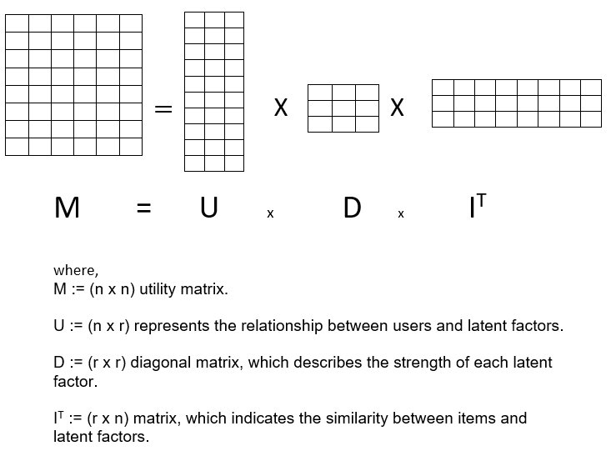
Matrix Factorization (SVD)
Ankit - are you making changes to this slide? Or is this final
Notes:
The latent factors here can be considered as genres. Based on how the users have rated the movies and movies similar to each other can come under one genre.
we are not using the actual genre of the movie as the latent features but based on ratings of users if we can figure out which movies are similar to each other we can basically say that they belong to one genre. Based on this Idea we can compute different latent features which here can be considered as genre.
SVD was used.
The missing values were imputed with zeroes.
Normalizing the user- item matrix using avg ratings of the movies.

Slide 8
Simulation Design
Begins each simulation with user movie ratings data
Runs base data through the recommendation engine to recommend a movie to ‘watch’
One movie generated for every user
Intentional randomness. User randomly pics 1 from their 5 highest recommended movies
Updates the user movie ratings database
Runs modified database through the rec engine again, for 2nd generation movie rec.
Up through 20 generations of movies.
Data, and thus recommendations, change over time
Simulation: repeat steps 1-4 multiple times
‘Alternate Universes’ of netflix binges.
Intentional randomness becomes important here
Simulation allows us to see trends in how recommendations tend to change

Slide 9
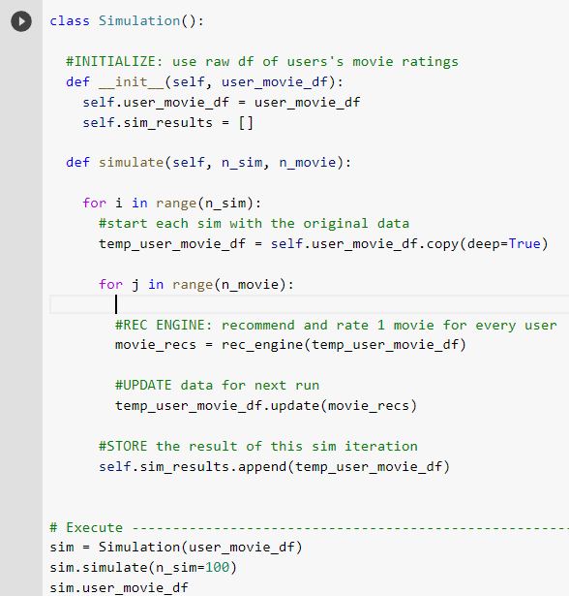
Methods:
Simulation -
Psueducode
Note the use of a simulation class

Slide 10
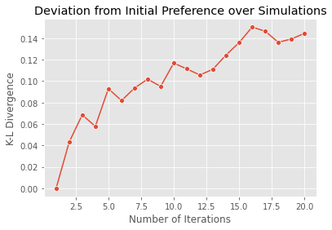
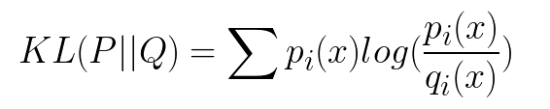
Results
Changes in group preferences over time
Calculate the initial genre distribution and the genre distribution of the ith iteration
Calculate the Kullback-Leibler divergence (KLD) between initial genre distribution and the genre distribution of the ith iteration

Slide 11
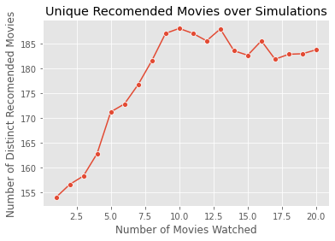
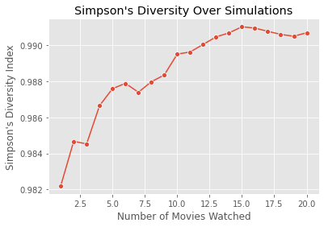

Homogenization of the User experience

Slide 12
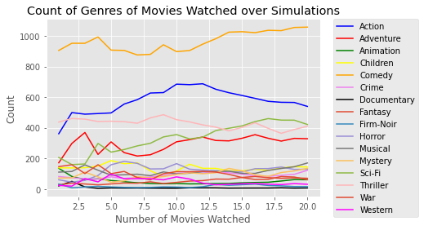
Popularity Bias
.

Slide 13
Summary
There was a higher deviation from the initial preference over time. This suggest that the taste of the users shift over time as more movies are watched by users
More unique set of movies are recommended over time as more movies are watched by users
More popular genres are more recommended over time as more movies are watched by users

Slide 14
References
Amatriain, X., Jaimes, A., Oliver, N., & Pujol, J. M. (2011). Data mining methods for recommender systems. In Recommender systems handbook (pp. 39-71). Springer, Boston, MA.
Recommendation Systems, Chapter 9, Rajaraman, A., & Ullman, J. D. (2011). Mining of massive datasets. Cambridge University Press.
Beheshti, B., Desmarais, M. C., & Naceur, R. (2012). Methods to Find the Number of Latent Skills. International Educational Data Mining Society.
Singular Value Decomposition (SVD) & Its Application In Recommender System, https://analyticsindiamag.com/singular-value-decomposition-svd-application-recommender-system/

Slide 15
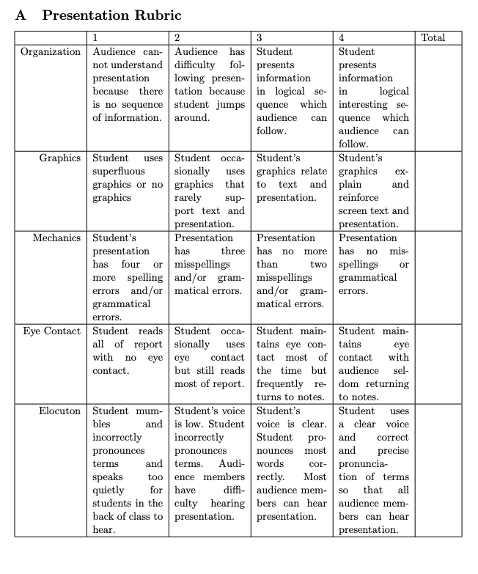
Rubric (for reference, this is the presentation rubric)

